Slide 1
Identification
Incident Response

Slide 2
Identification
Identifying that there IS a problem
There’s a wide range of problems
Data theft
DDOS
Elevation of privilege
Malware/virus outbreak
Phishing
Root access
Unauthorized access
Detecting the incident initially is often the most challenging piece

Slide 3
Signs of an Incident
Precursor
Incident may happen in the future
Logs of web server getting scanned
New vulnerability is announced
Eternalblue & WannaCry
Intelligence of an upcoming attack

Slide 4
Signs of an Incident cont.
Indicator
Incident may have already happened
NIDS Sensor alerts when DB server is attacked
AV on a host detects malware
System administrator sees something weird
This is rare
Why?
Host changes and the change is logged
Failed logins (application, system)
Deviation in network traffic

Slide 5
Intrusion Identification Data Sources
Once we’ve gotten into an incident response, we won’t have a lot of say
Have to use what’s available as a start
Can go deeper on a more specific host level later, talking broadly for now
If at all possible, get out ahead and setup good logging and detection
Network-based data
Who’s talking to who?
What ports/protocols are they talking over?
Host-based data
What processes are running?
Filesystem changes?
Hybrid
What processes are talking to what remote machine?

Slide 6
Intrusion Identification Data Sources
IDS, IPS
SIEM
AV
File integrity checks
Third party monitoring software
Logs
People
Internal
External

Slide 7
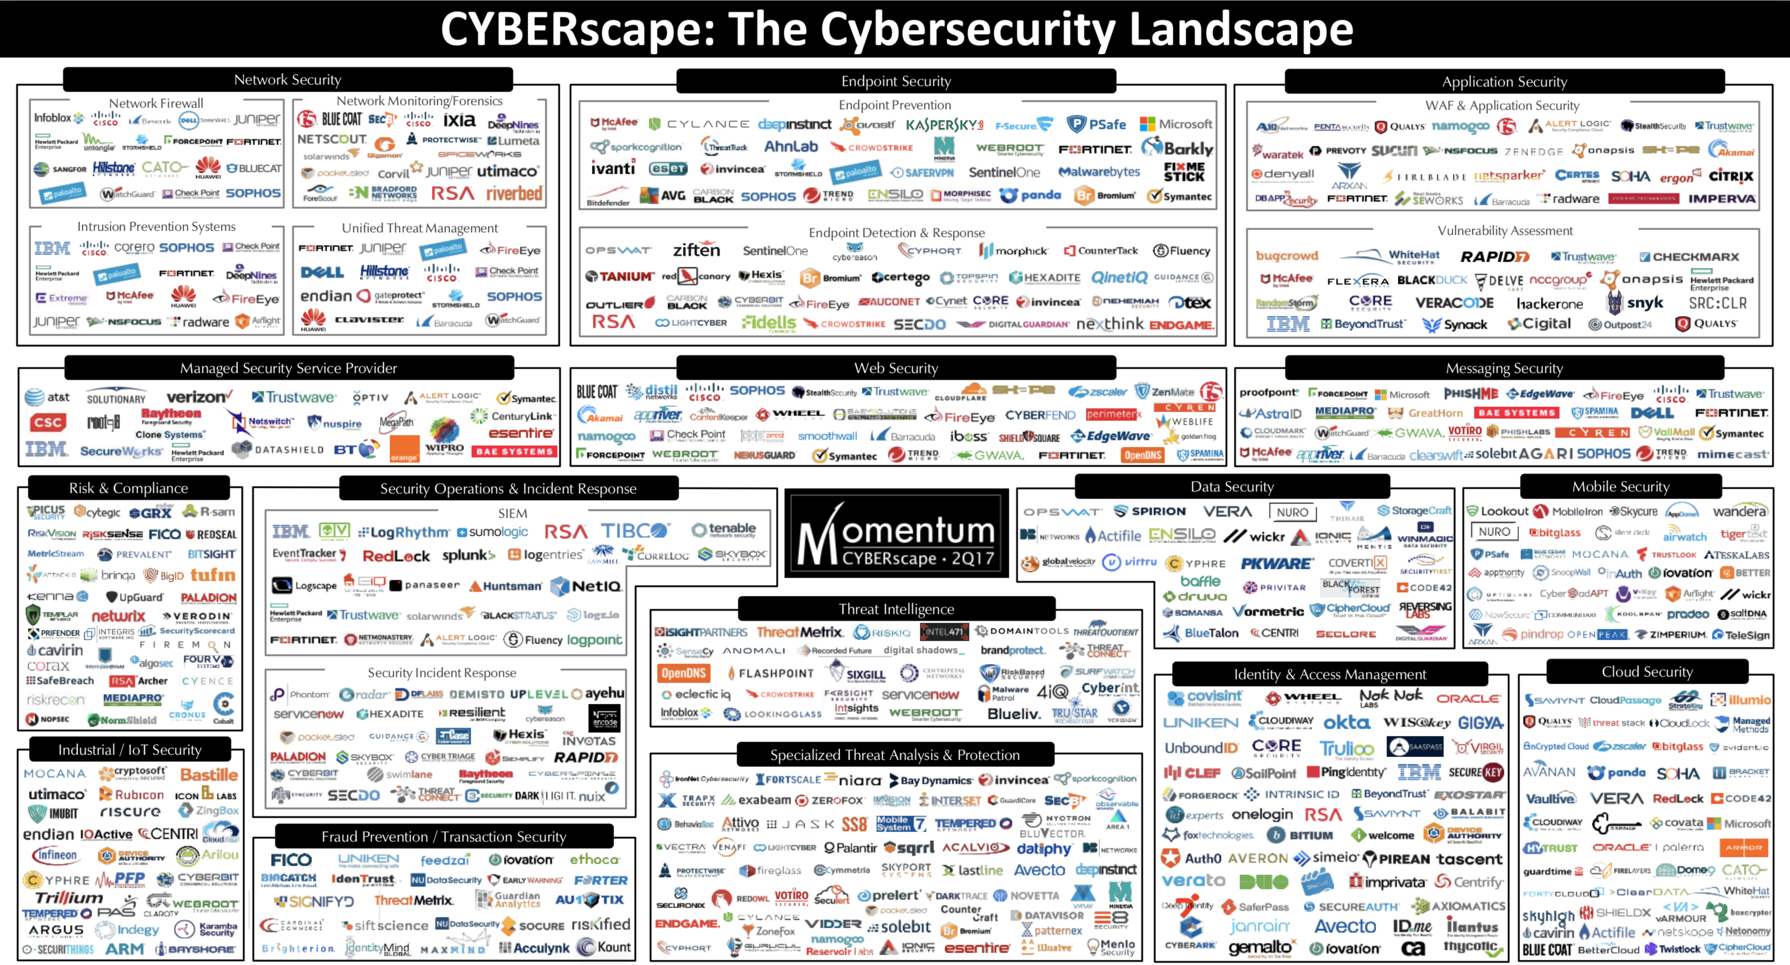
No silver bullet here
Momentum Partners

Slide 8
Network vs. Endpoint
Network Level
Often at network boundaries
Monitor incoming and outgoing traffic
Easier exfil detection
Protocol level analysis
What if the traffic is encrypted?
SSH
HTTPS/SSL/TLS
Might not provide intranet visibility between hosts
Lateral movement detection
Endpoint Level
Detection on each endpoint
Workstations
Servers
Mobile Devices
Process level details
May be difficult to manage thousands of endpoints

Slide 9
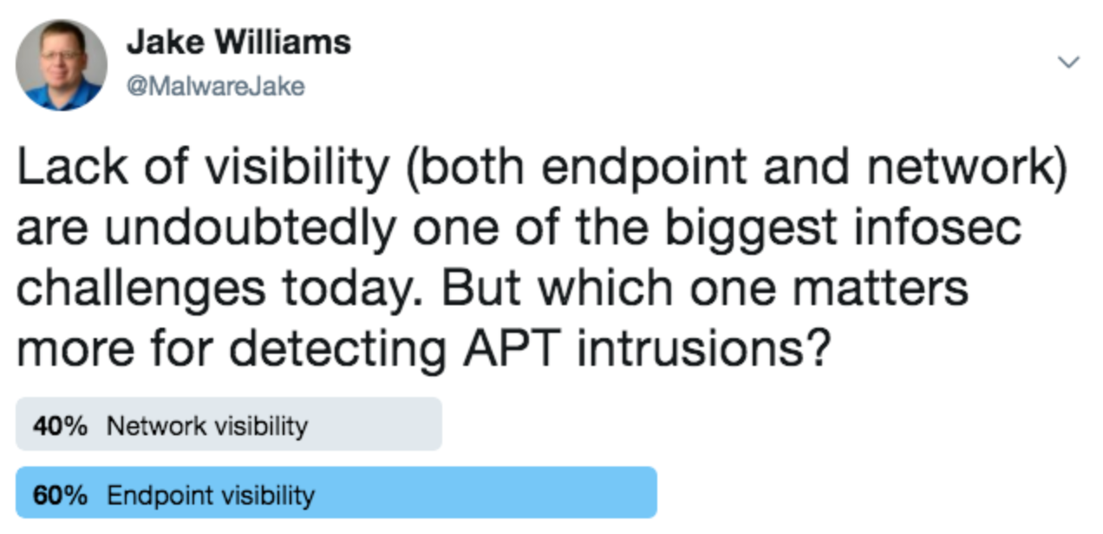
Network vs. Endpoint

Slide 10
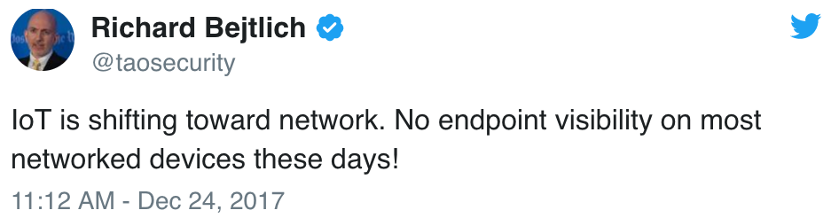


Some responses…
Network instrumentation is probably better for detection, while endpoint detection is probably more useful for investigation
https://www.renditioninfosec.com/2017/12/network-or-endpoint-monitoring-if-you-can-only-do-one-which-one/

Slide 11
Data Collection Tools
Some common ones you may come across…
Network
Bro
Captures Traffic
Analysis engine
Snort and Suricata
Extract metadata from network traffic
Files
DNS Requests
Certificates
…etc
Host
Windows Event Logs
Sysmon
Process Information
Network Connections
Disk Read/Writes
DLL Loading
Cylance
CarbonBlack
…etc
SIEM = Security Information and Event Management
Splunk
ArcSight
ELK
Logrhythm
Graylog
…etc

Slide 12
Forensic Artifacts and Data Fields
Network-based
Session Information
Source IP
Destination IP
Source Port
Destination Port
Time
Bytes In
Bytes Out
URLs
Host-based
Process Information
Full command line
Parent Process
Hash
File Changes
File Name
File Path
Modification Time
Session Authentication
Username
Logon time
Login Source IP

Slide 13
Incident Analysis
What if a precursor or indicator is false?
What if the indicator is true?
This still doesn’t necessarily mean there is an incident
You’ve got one of these, where to go next?
Profiling networks and systems
Understanding normal is important
Log retention
This can be challenging
Correlate data
Start collecting more data around the indicator

Slide 14
Incident Documentation
From the initial indicator or precursor, documentation should start
Status of the incident
Indicators
Correlated data
Chain of custody and lines of communications
Contact info for everyone involved
Evidence
Comments
Recommendations

